Slide 1
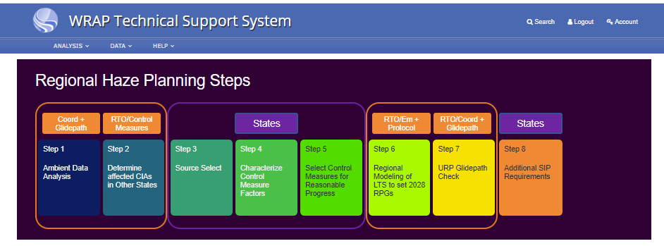

WRAP Revised TSS: Regional Haze SIP 8-Step Process
Interim draft products
Coordination and Glidepath Call April 16, 2020

Slide 2
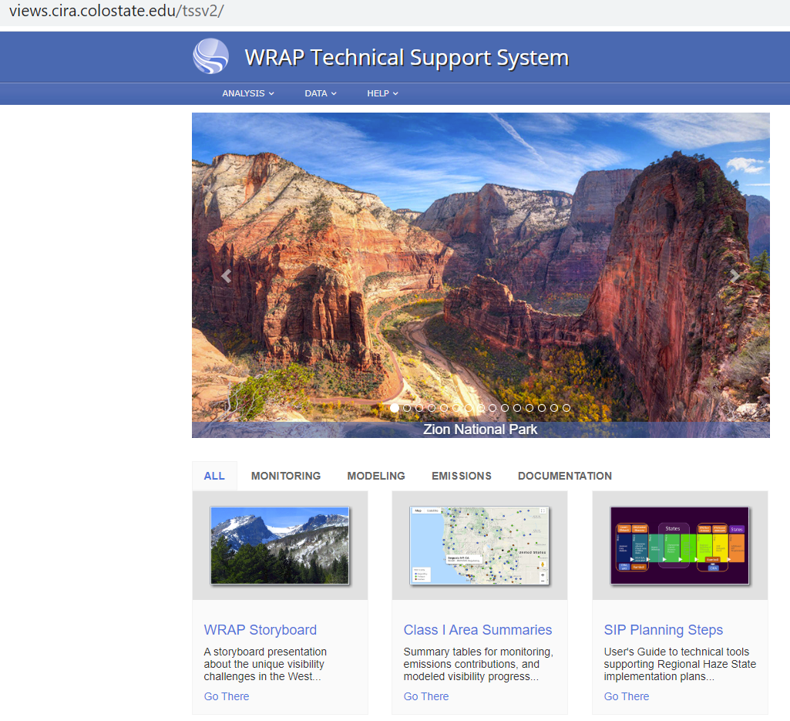
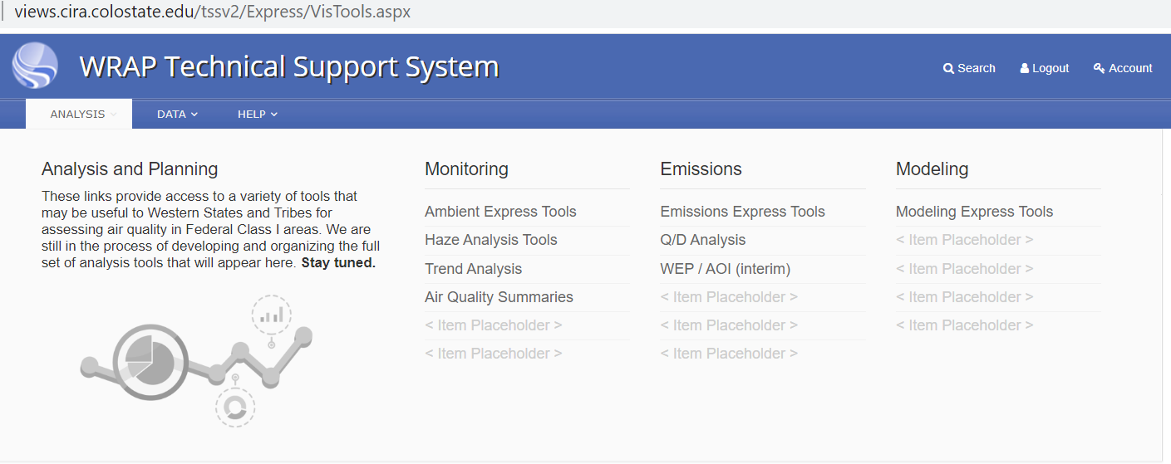


WRAP TSS Tools for RH SIP 8-Step Process
2 ways to access new SIP express tools

Slide 3
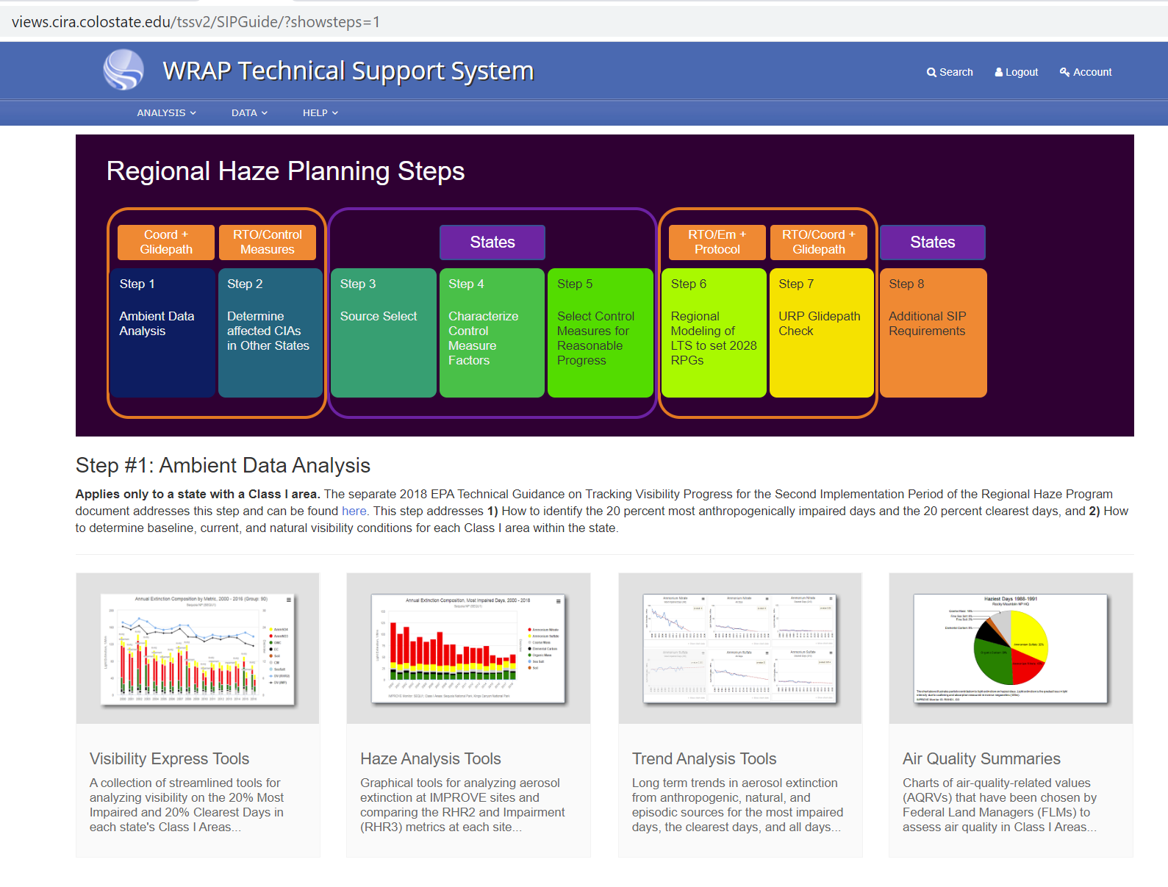

Step 1: Ambient Data Analysis
New Charts
https://views.cira.colostate.edu/tssv2/HazeAnalysis/Default.aspx?appkey=HACF_VisSummary
Existing Tools on TSS2

Slide 4
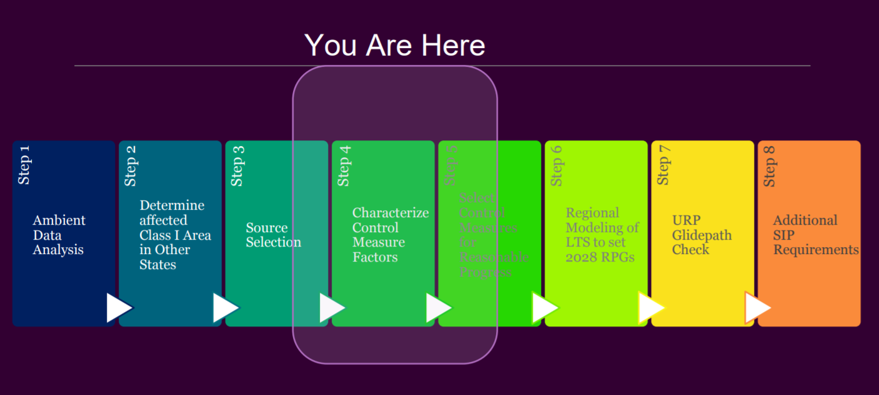
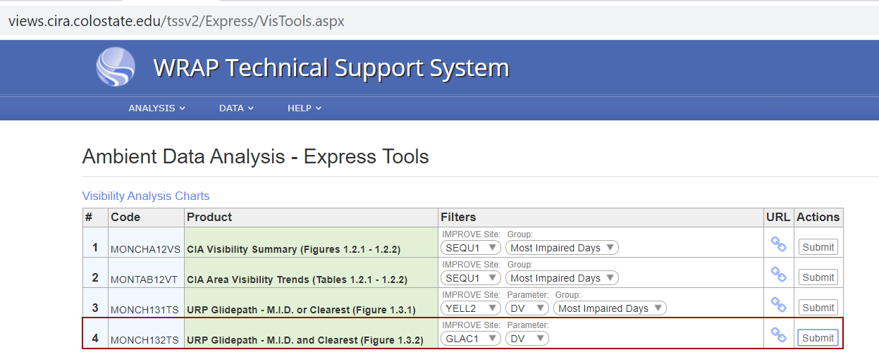
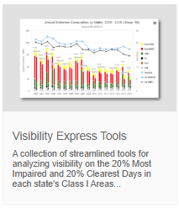
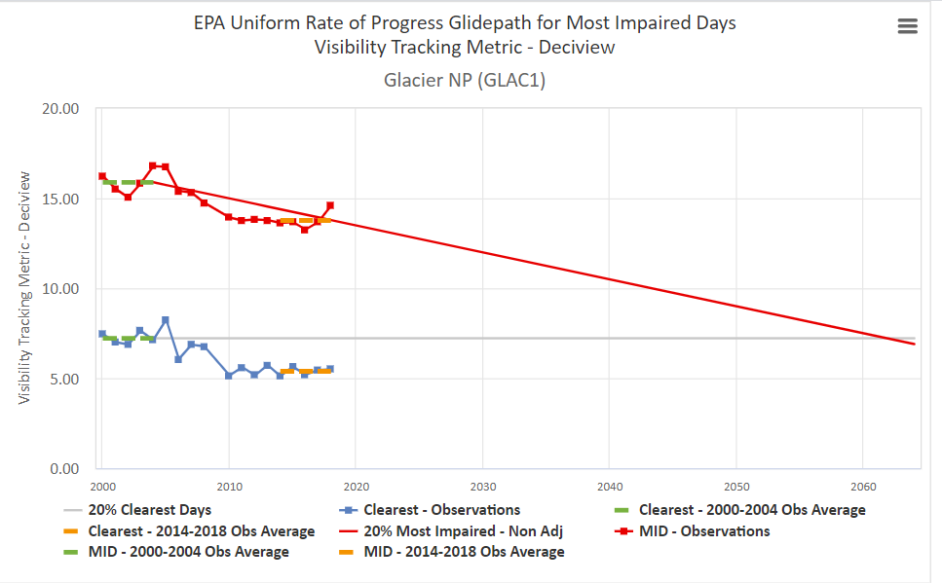
Step 1: Visibility trends – Express Tools

Slide 5
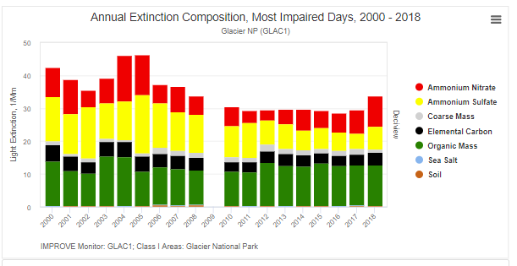
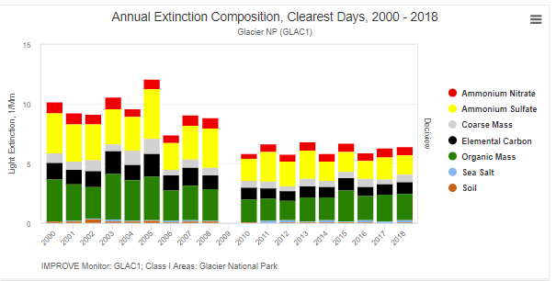


Step 1: Visibility trends and aerosol contributions: Express
Not yet available in Express Tools, use Haze Analysis Tools, Annual Trends

Slide 6
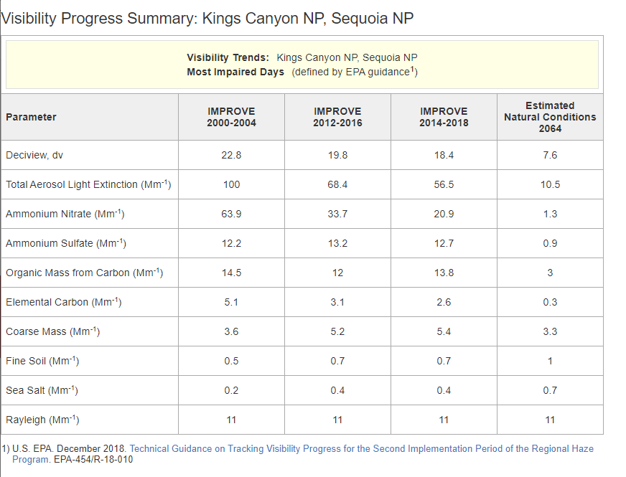

Step 1: Ambient Data Analysis: Express Tools
https://views.cira.colostate.edu/tssv2/Express/VisTools.aspx

Slide 7
Step 1: Ambient Data Analysis: Express Tools
Planned, yet available
State Name – Class I Area Visibility Trends Summary – Deciview Most Impaired Days (defined by EPA guidance¹)
Deciview, dv | IMPROVE 2000-2004 | IMPROVE 2008-2012 | IMPROVE 2014-2018 | 2064 Estimated Natural Conditions¹ | 2018 ¹ Uniform Rate of Progress | 2028 ¹ Uniform Rate of Progress
Bridger Wilderness
Fitzpatrick Wilderness²
Grand Tetons NP³
North Absaroke Wilderness
Red Lakes Wildlife Refuge Wilderness³
Tetons Wilderness³
Washakie Wilderness⁴
Yellowstone NP

Slide 8
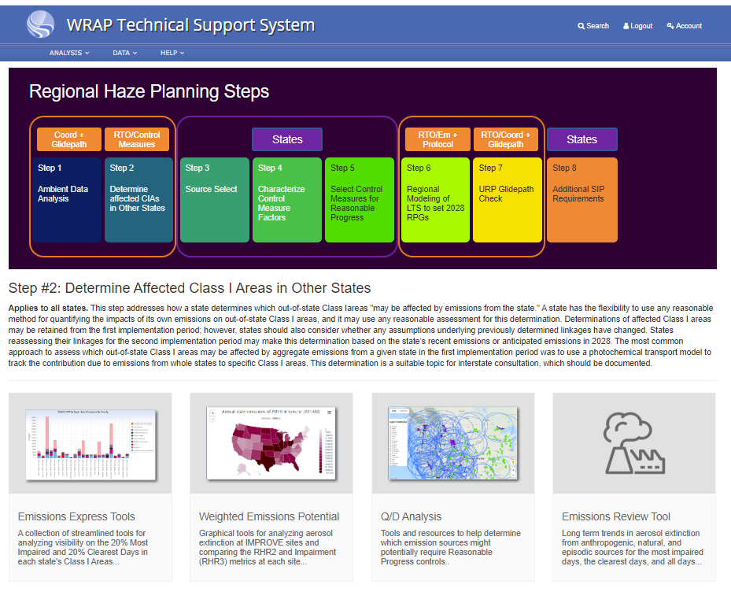
2028
2014

Slide 9
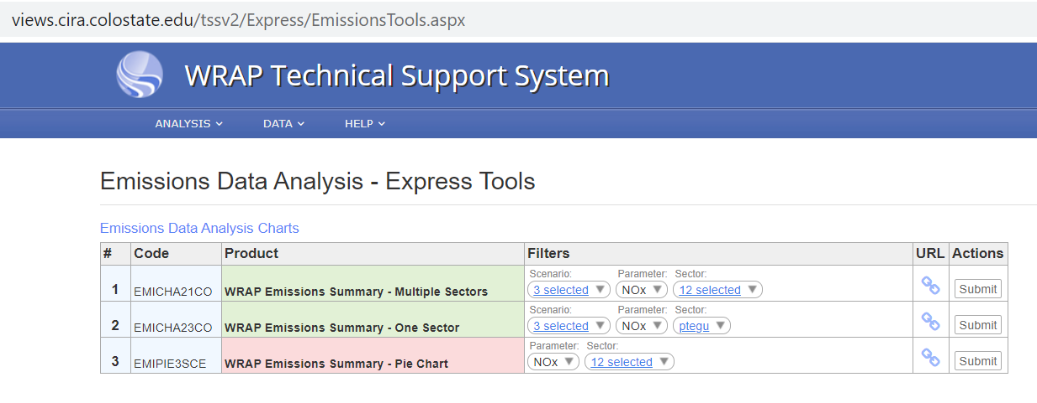
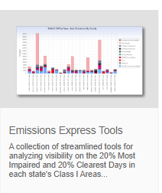
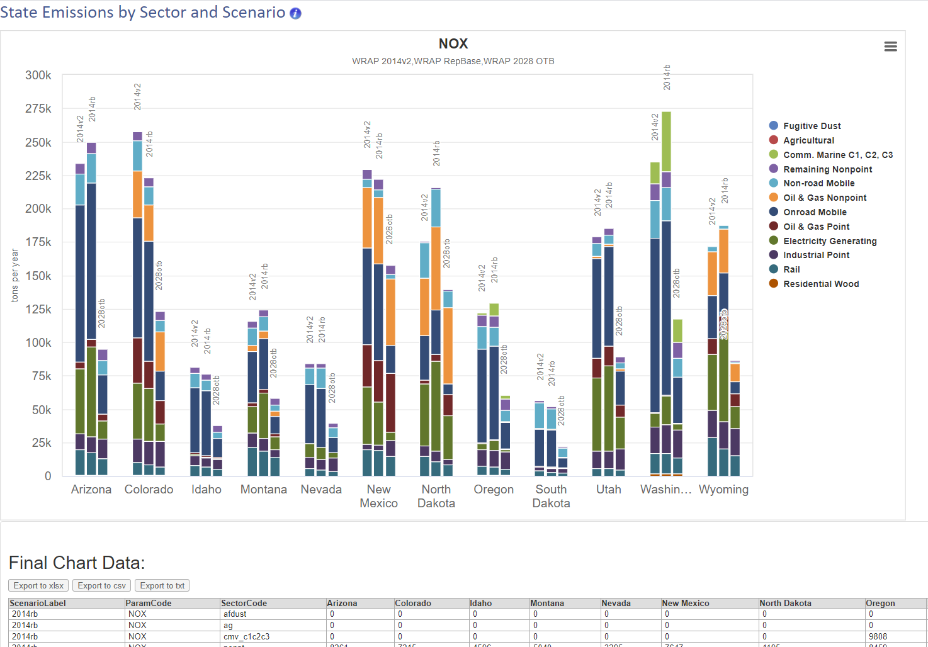
Step 2a: Emissions Inventories: Hit List
CA to be added

Slide 10
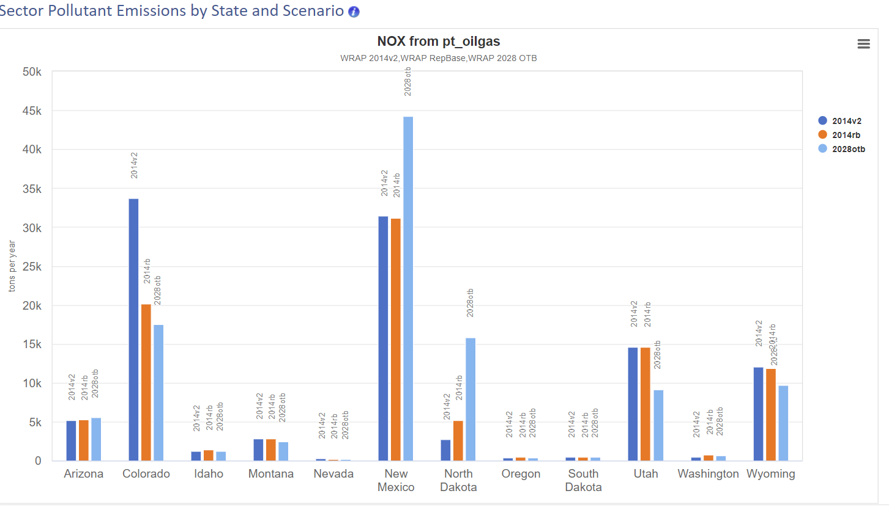
Step 2a: Emissions Inventories: Hit List

Slide 11
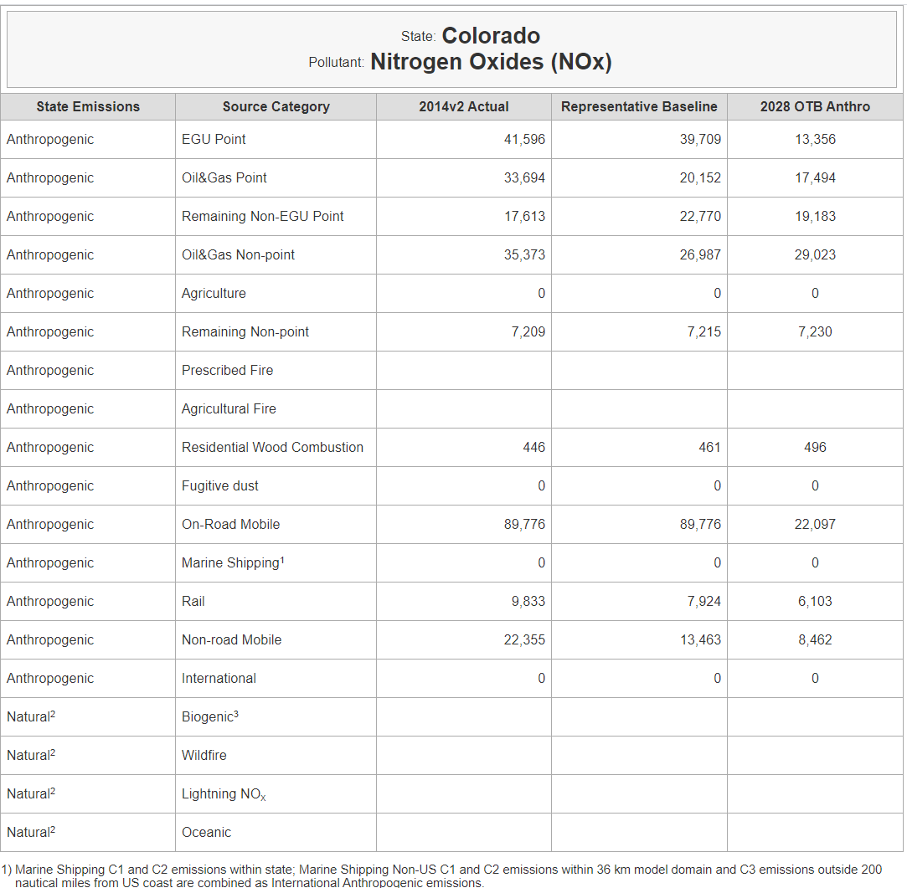
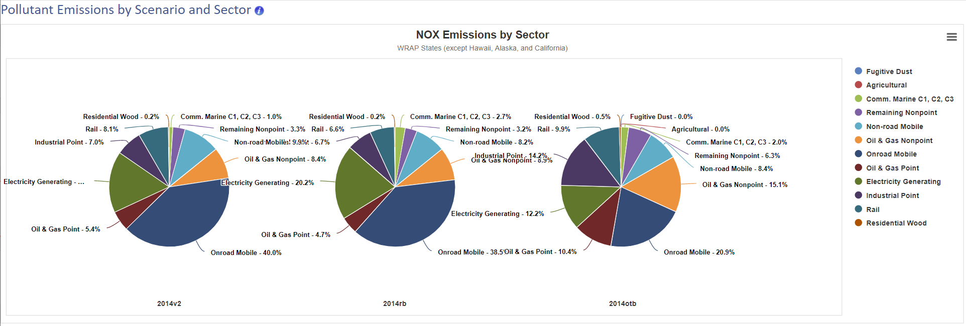
Step 2a: Emissions Inventories: Hit List
Summary Emissions Table, for example: CO
13 WRAP states summary across Scenarios and Sectors
Natural Windblow Dust
RepBase
2028 OTB
Add state barchart
Add Annual Total Emissions tons/yr below each scenario

Slide 12
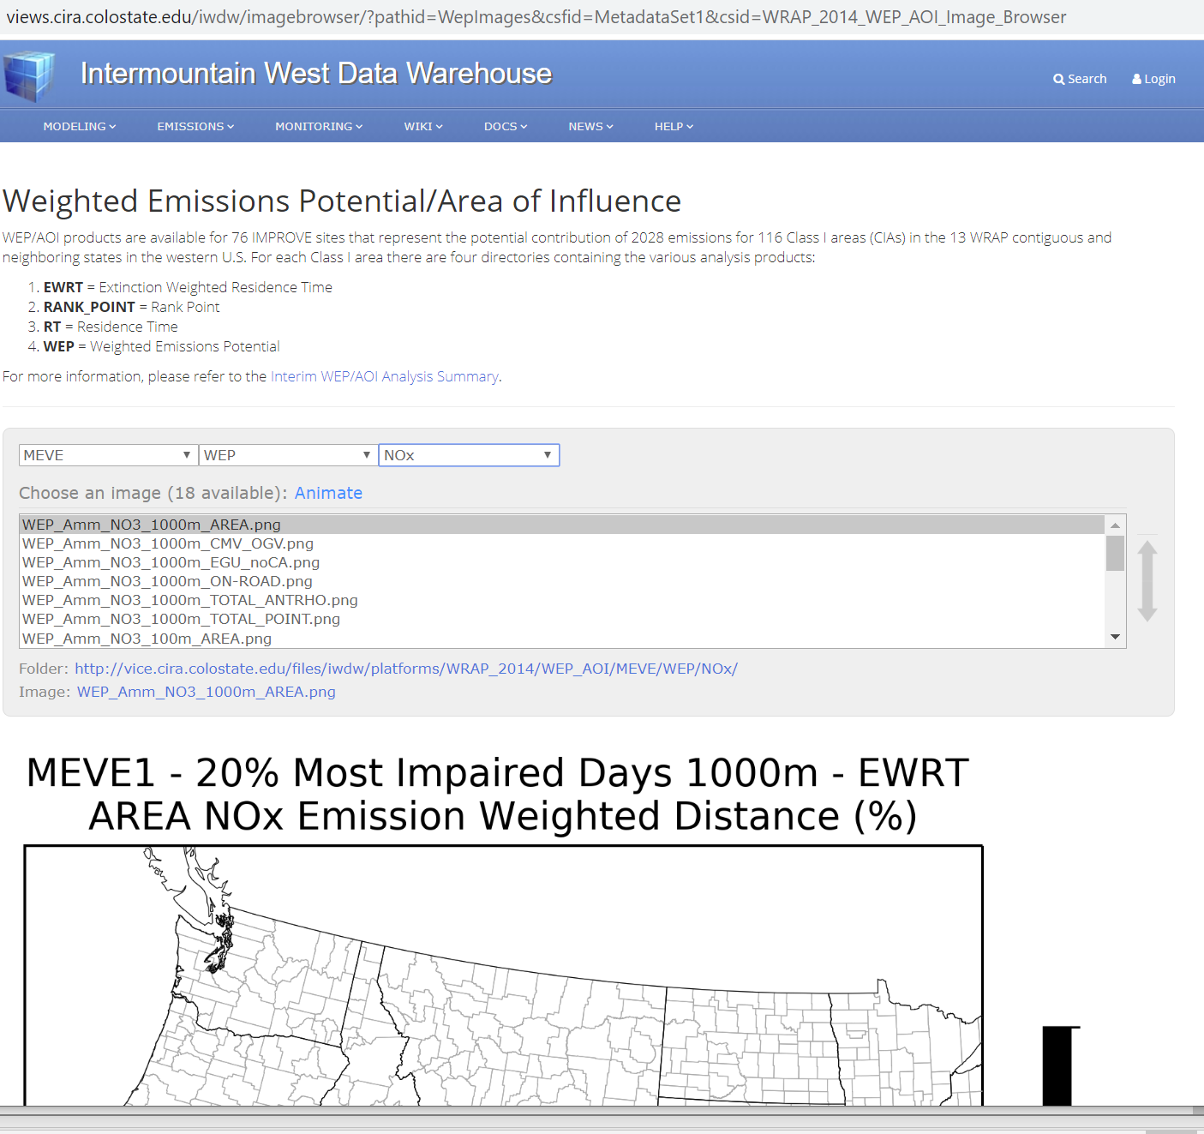
Step 2: Emissions Contributions to Class I areas
Step 3: Source Selection – 2028 Weighted Emissions Potential
Use:
Not yet functional

Slide 13
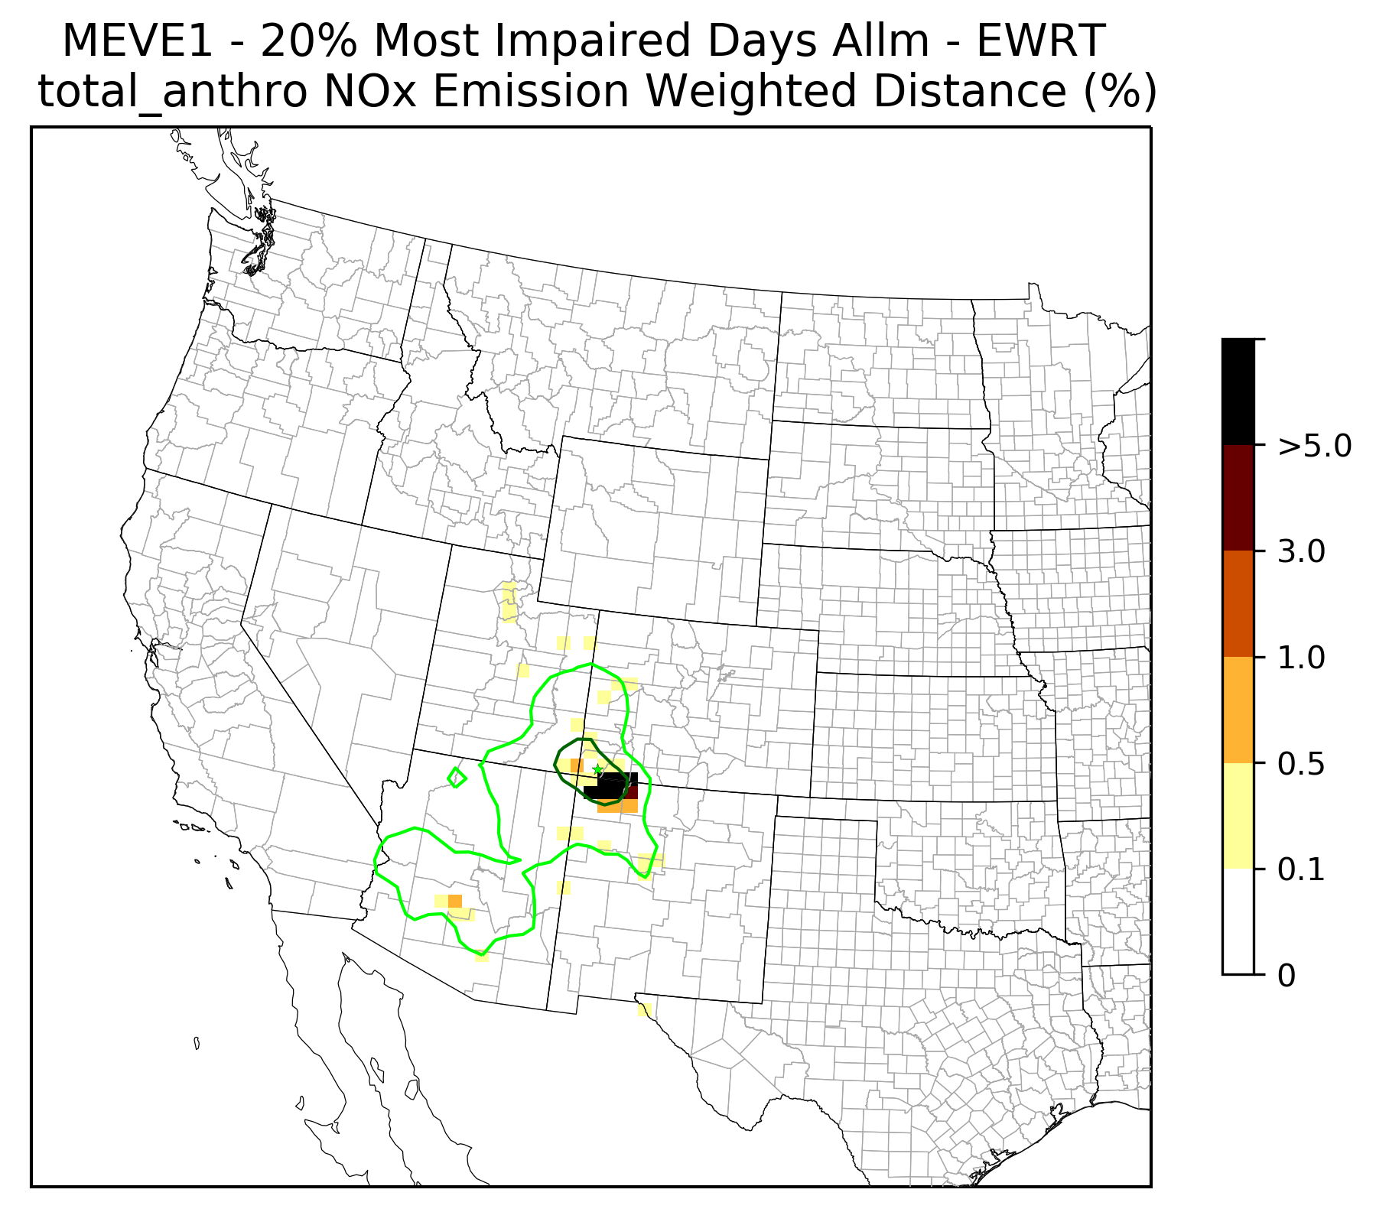
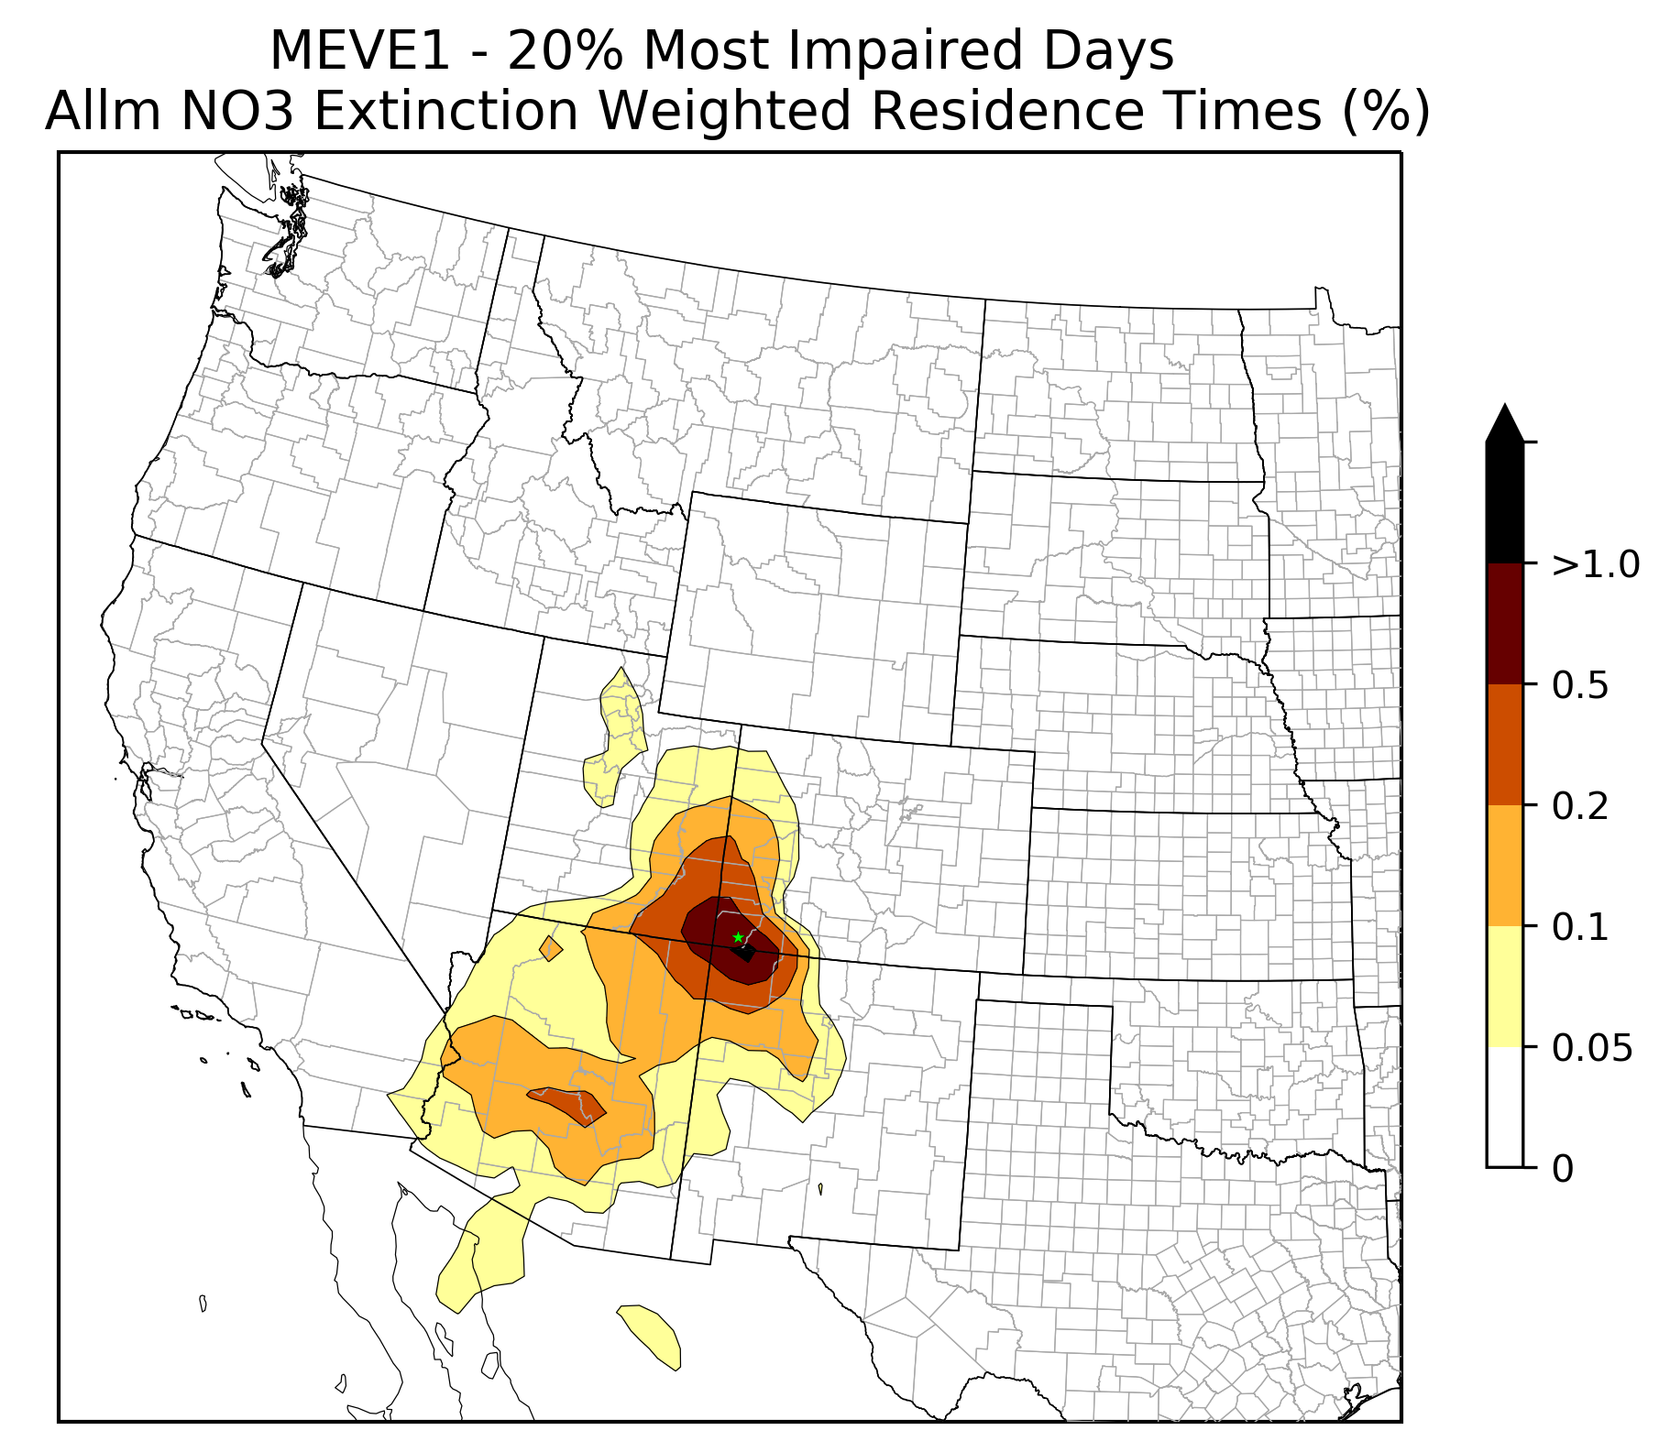
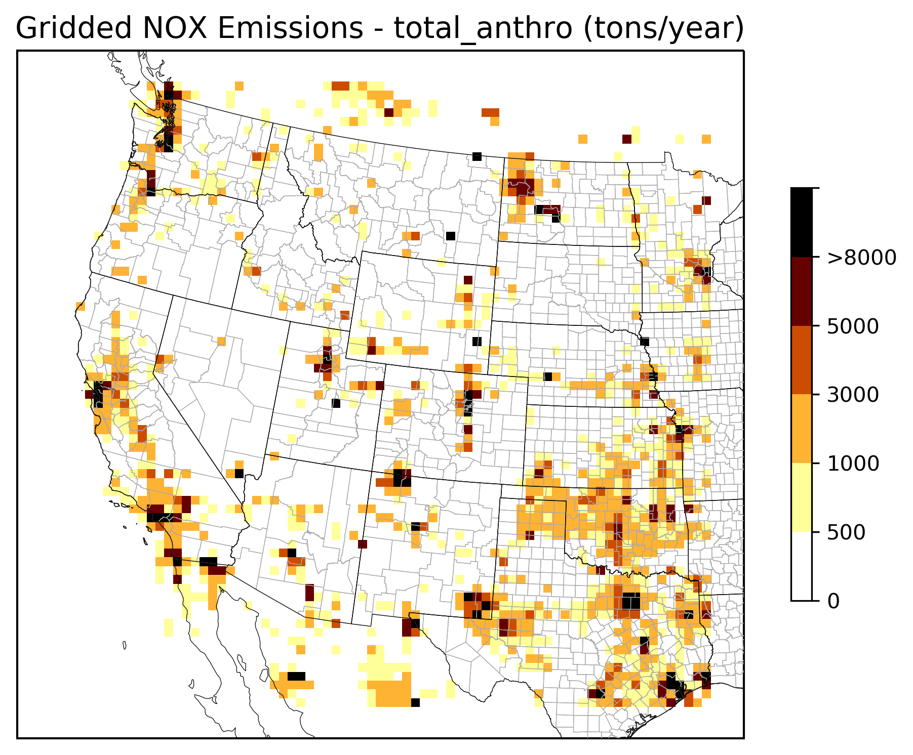
Step 2b: Emissions Contributions to Class I areas:
2028 Weighted Emissions Potential (WEP) – Mesa Verde Example
Weighted Emissions Potential (WEP)
2028 NOx WEP All Anthro
+
=
Not yet linked

Slide 14
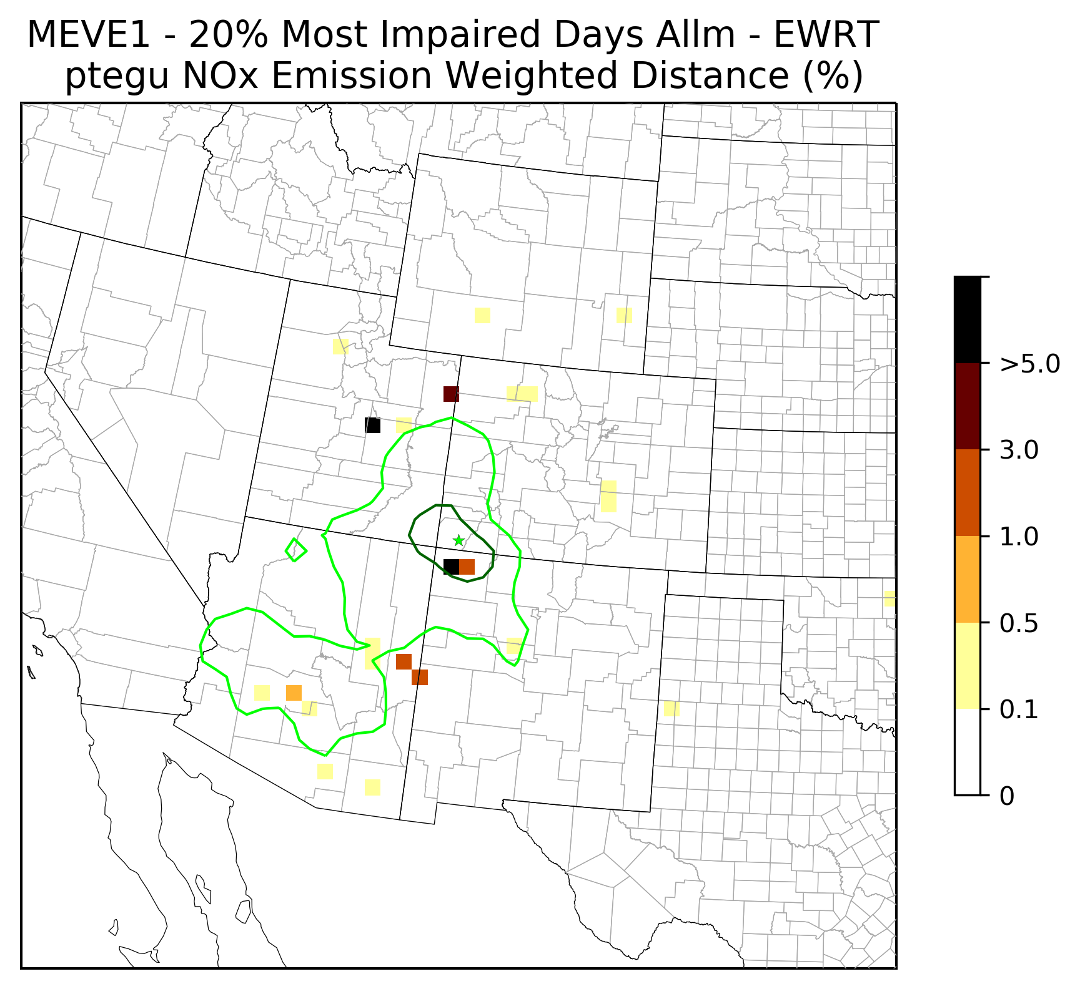
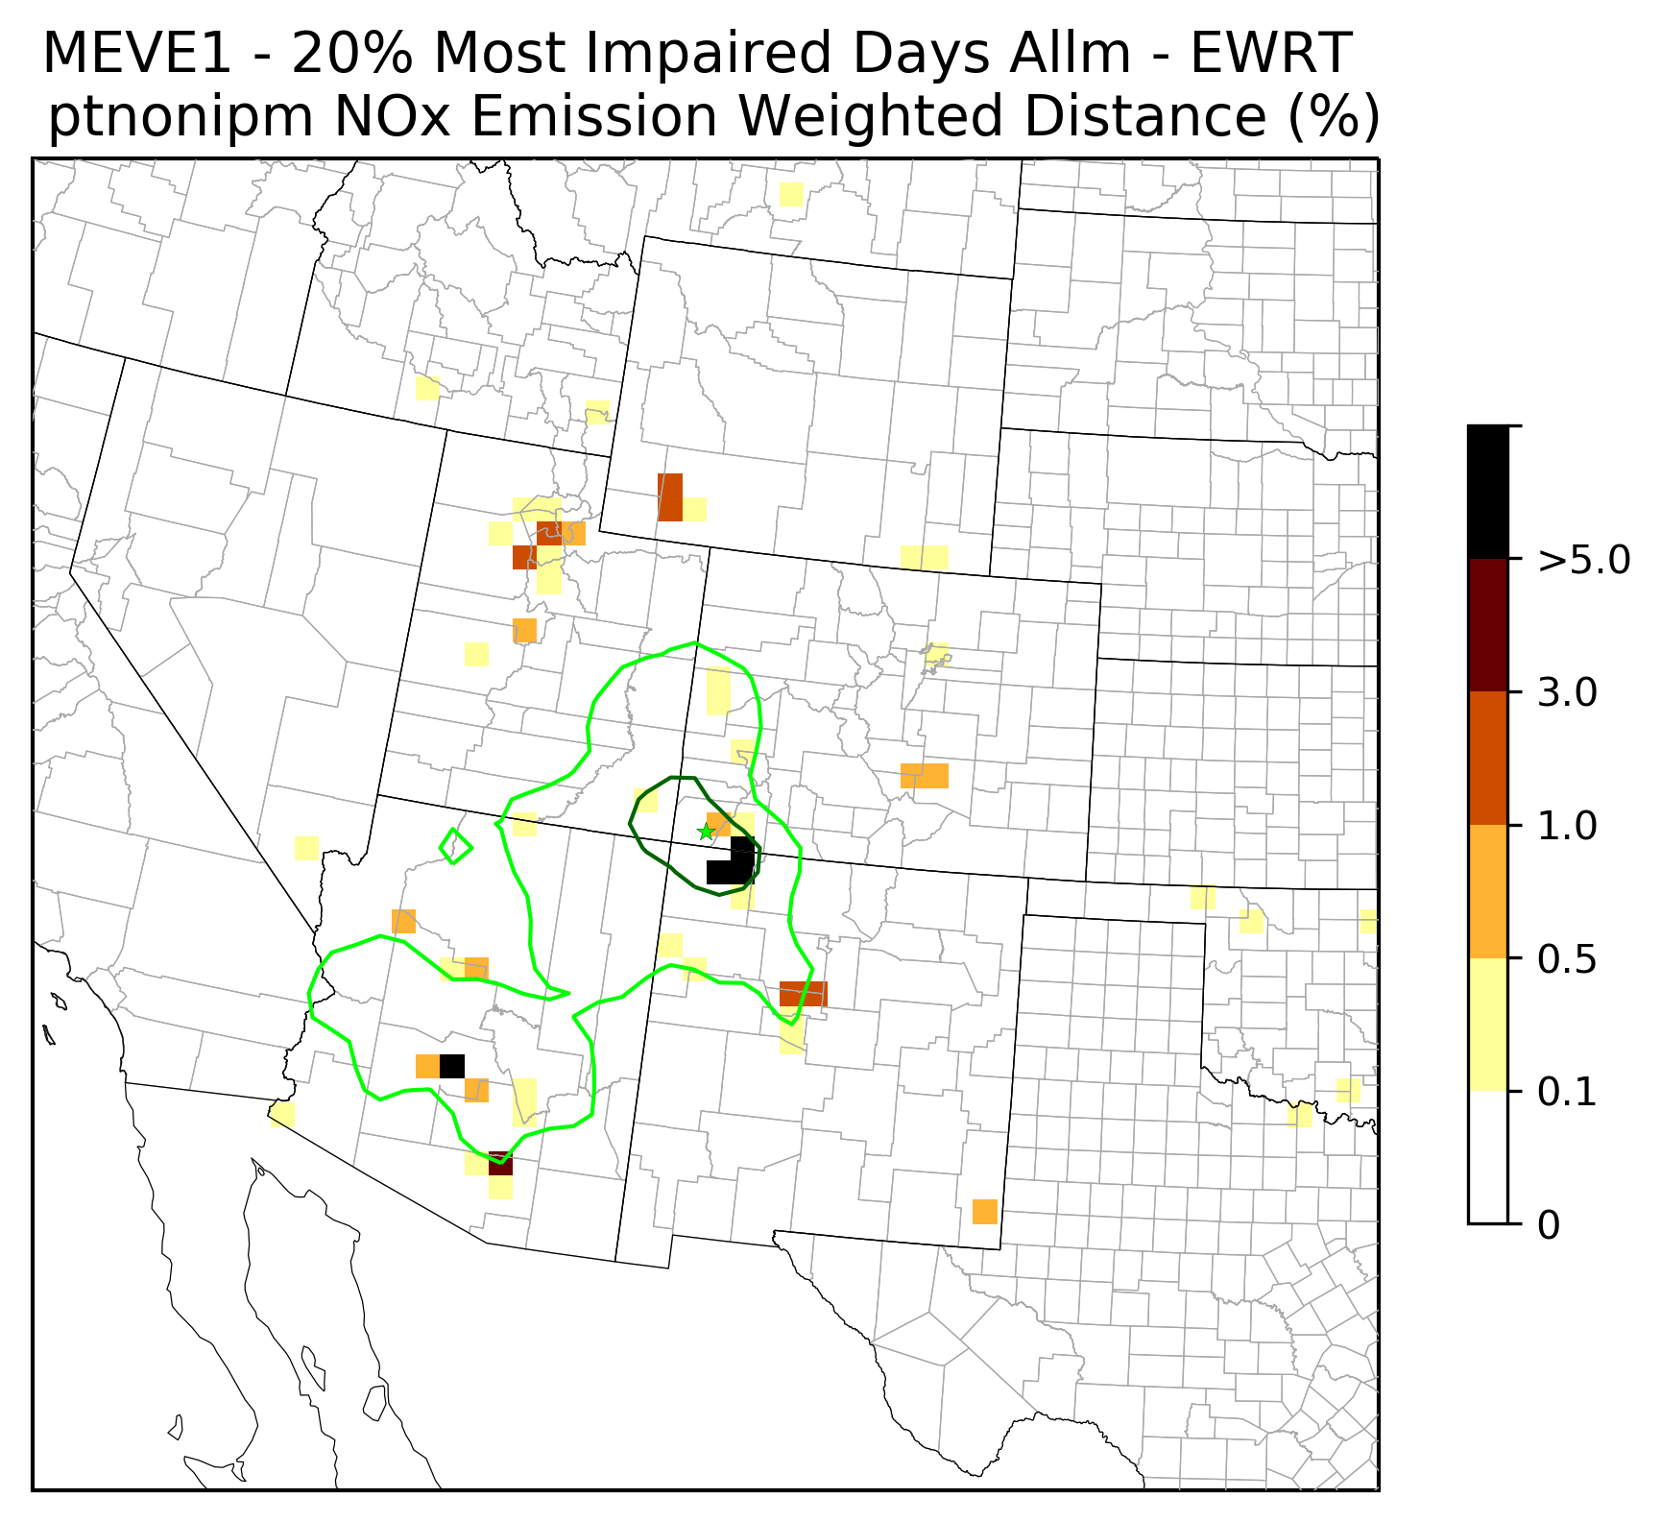
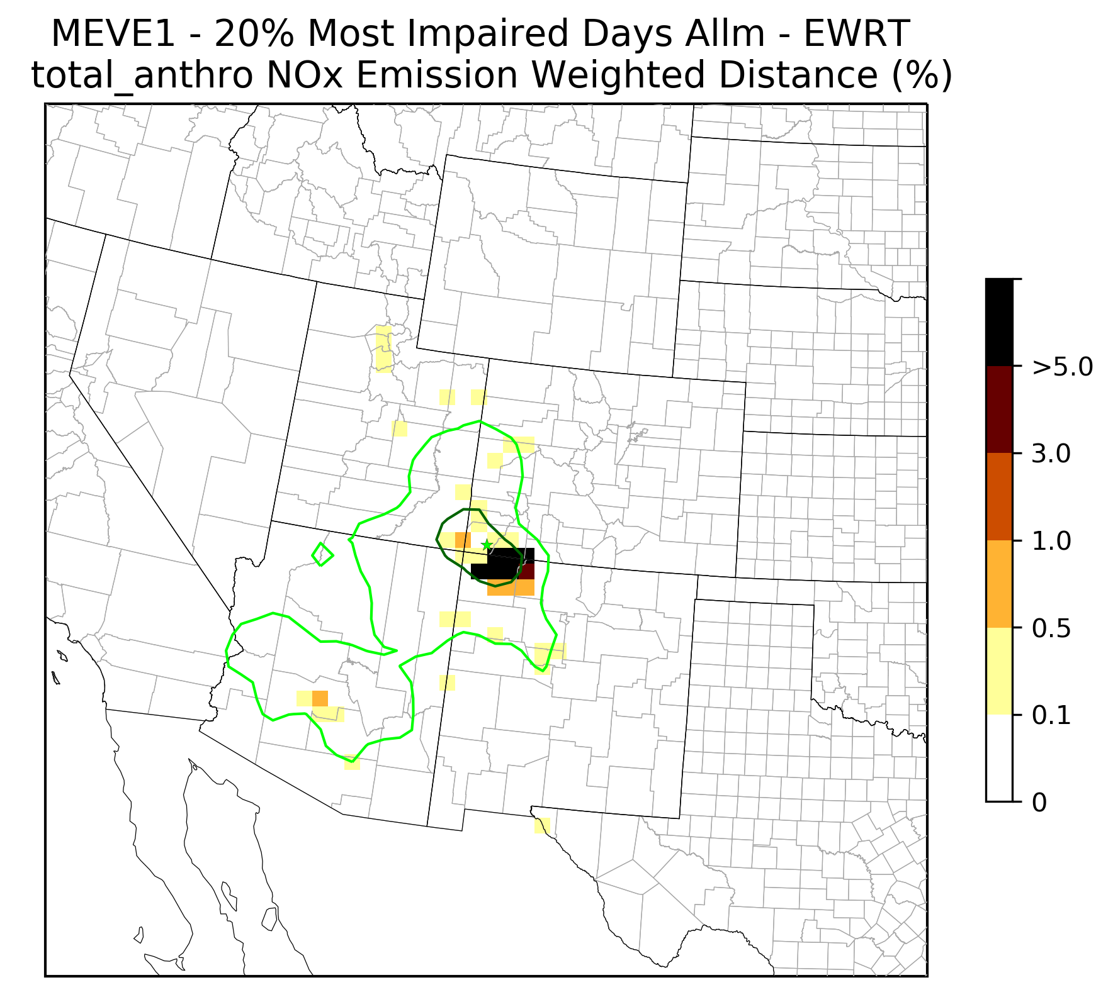
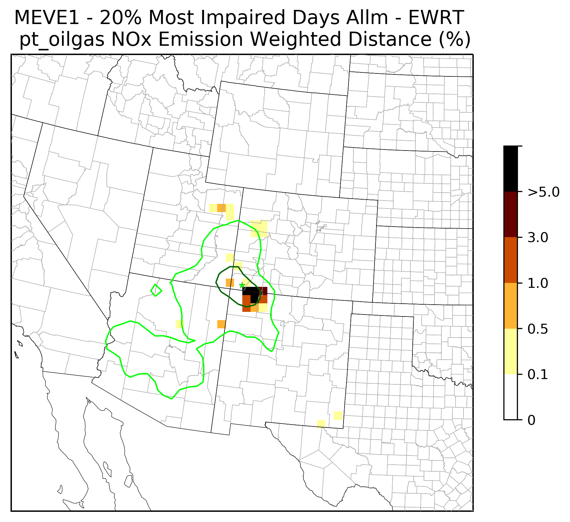
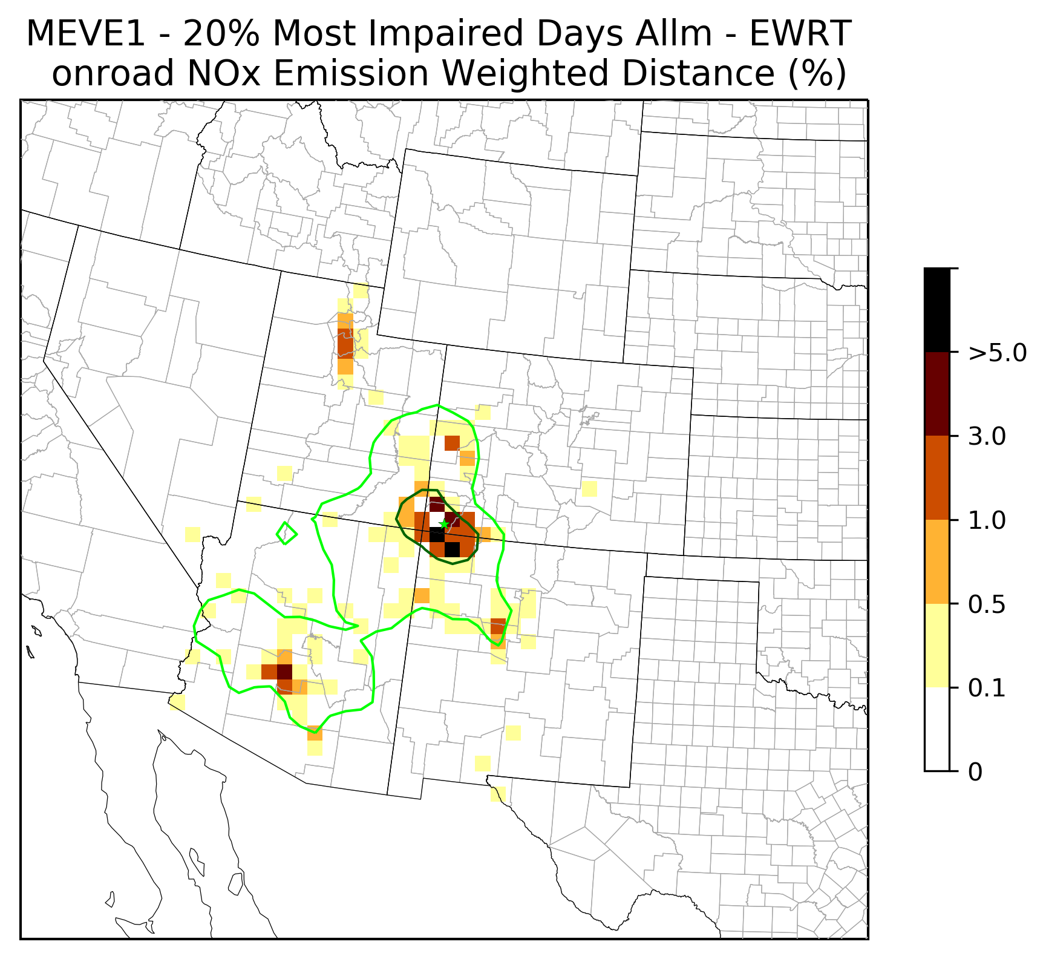
Step 2b: 2028 Weighted Emissions Potential (WEP):
EGU Point
Non-EGU Point
Total Anthropogenic
Example: NO3 at Mesa Verde
Total Anthro
O&G Point
On-Road Mobile

Slide 15
Step 3: Point Source Selection
2028 WEP: SO2 and NOx Ranked Point Sources
Canyonlands Example

Slide 16
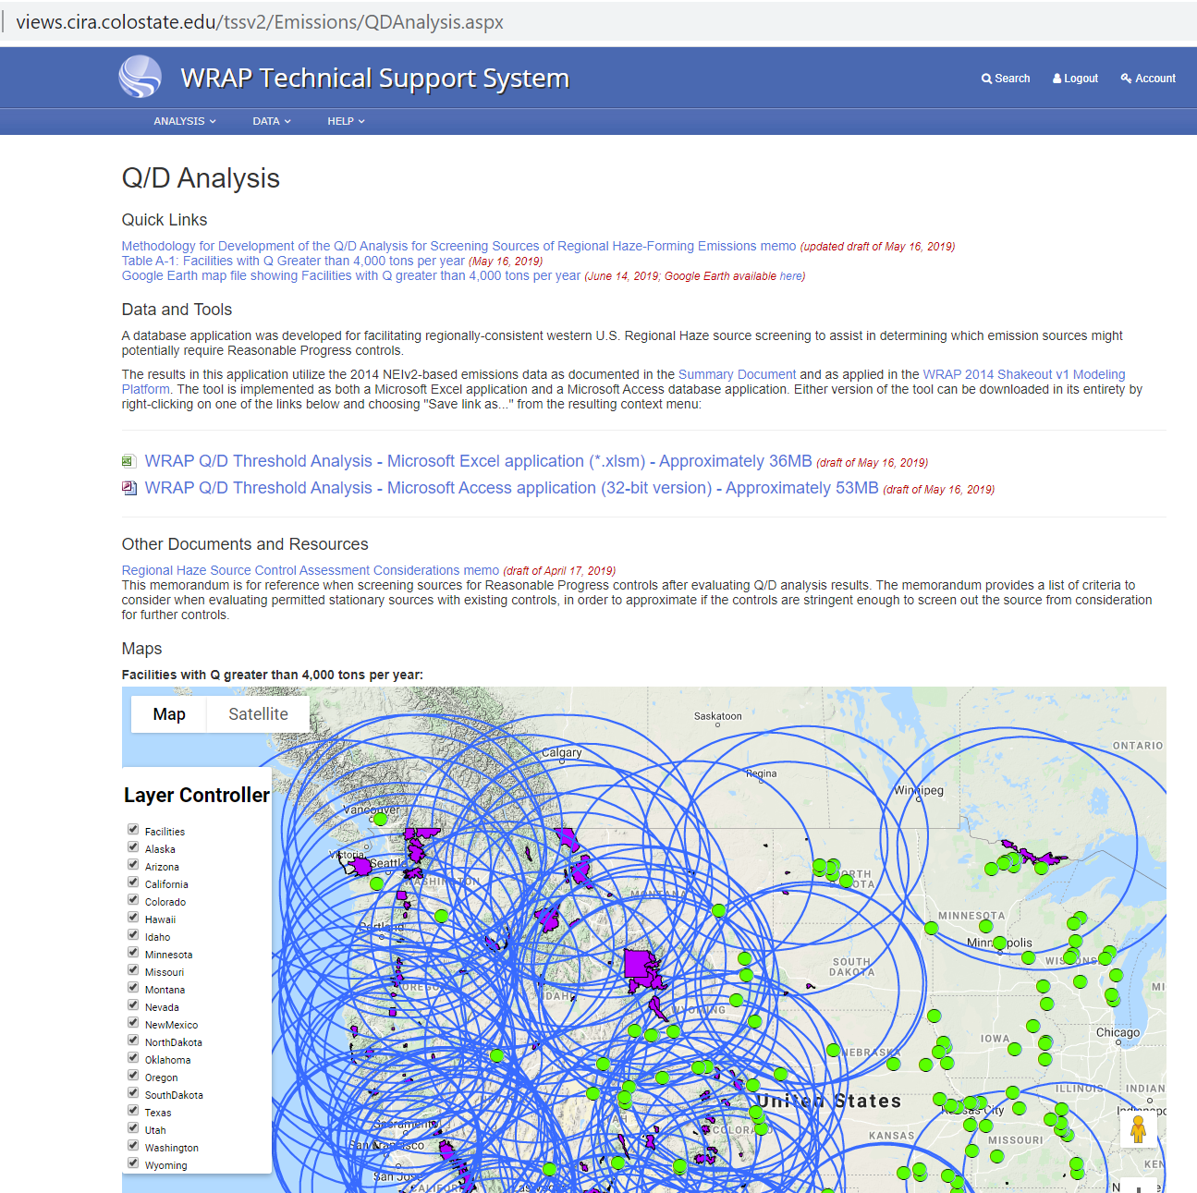
Step 3: Source Selection –
2014 Emissions divided by distance (Q/d)
Not yet functional
Use:

Slide 17
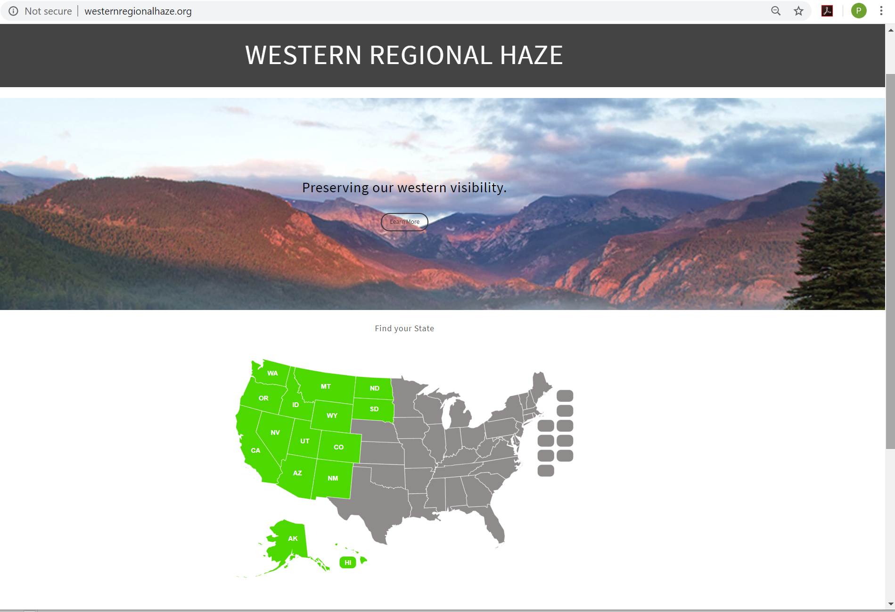
Steps 3,4, and 5: Review of emission sources and potential future controls.
WRAP states conduct 4 factor analyses, see url below.
WRAP Regional Contributions:
WRAP Control Measures
Subcommittee developed
protocol for selecting sources.
WRAP evaluated future controls:
  EGU
  Oil and Gas
  On-road mobile
links to work products to be added

Slide 18
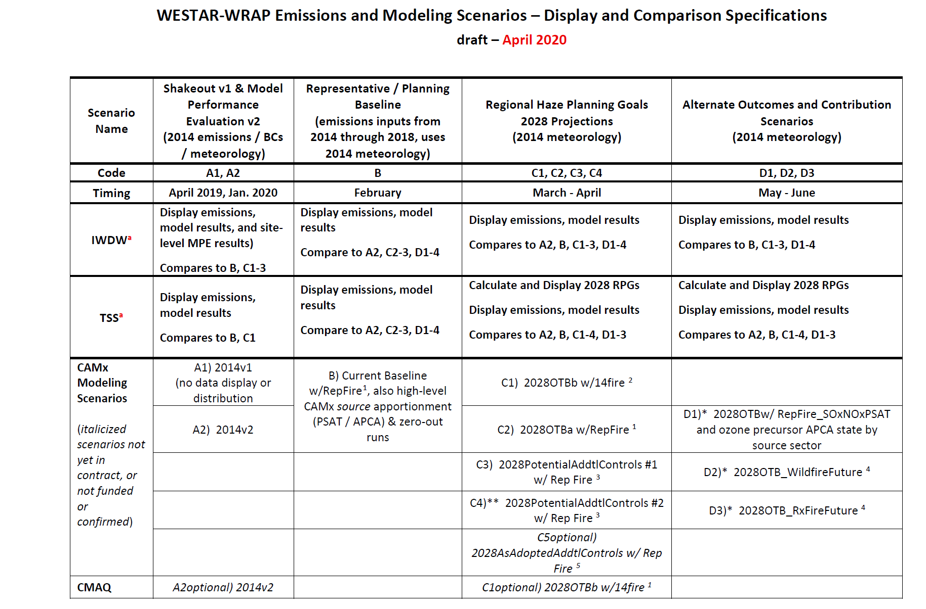
Steps 6: Modeled 2028 Visibility Projections

Slide 19
Steps 6: Modeled 2028 Visibility Projections
Model to Observations: Model performance
  2014v2
  Representative Base
2028 OTB scenarios
Zero Out Sensitivities and PSAT to define international anthropogenic contributions at Class I areas
Dynamic Modeling to define US Anthropogenic contributions in 2002, Rep Base, 2028 OTB
2028 PSAT Source apportionment to define state and anthropogenic source sector contributions

Slide 20
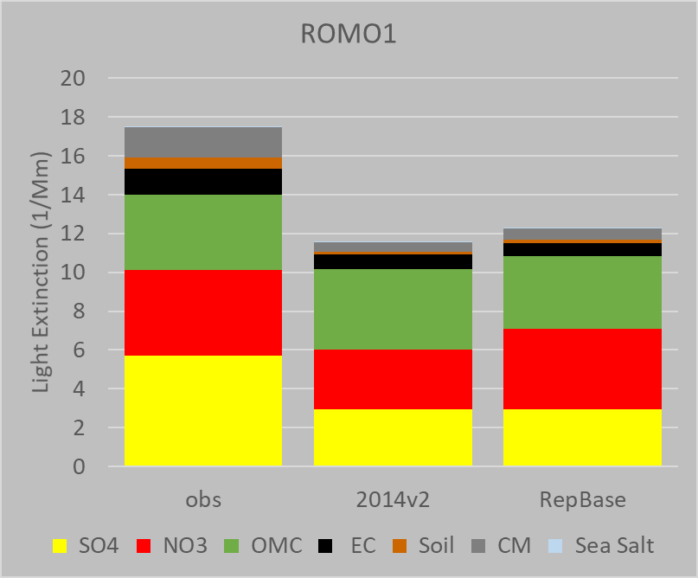
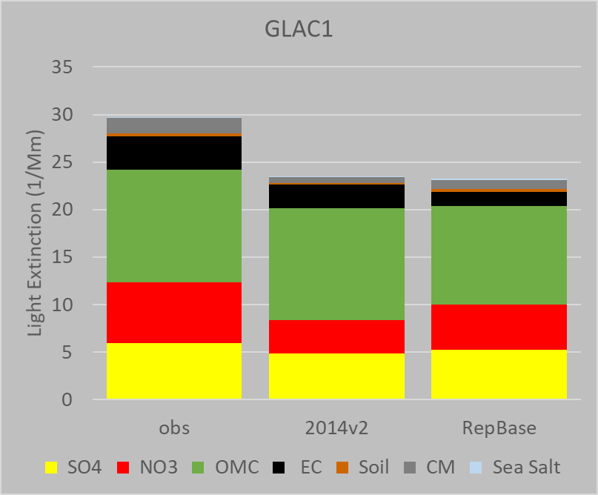
Step 6a: Model to Observations
2014v2 and Representative Base CAMx modeled aerosol light extinction on Most Impaired Days compared to 2014 IMPROVE observations

Slide 21
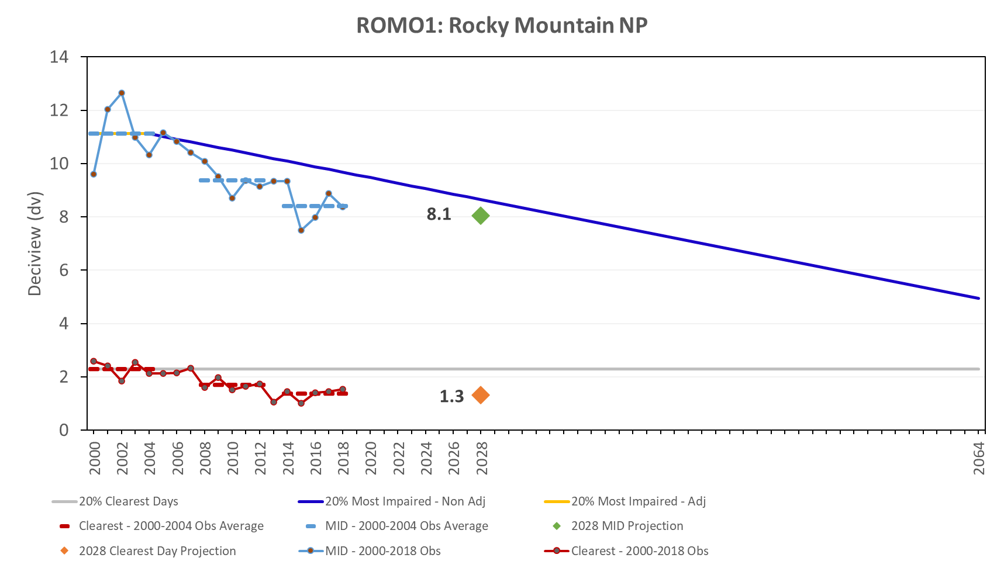
Step 7a: EPA Default Glidepath
and WRAP 2028 Visibility Projections
Ramboll Prototype

Slide 22
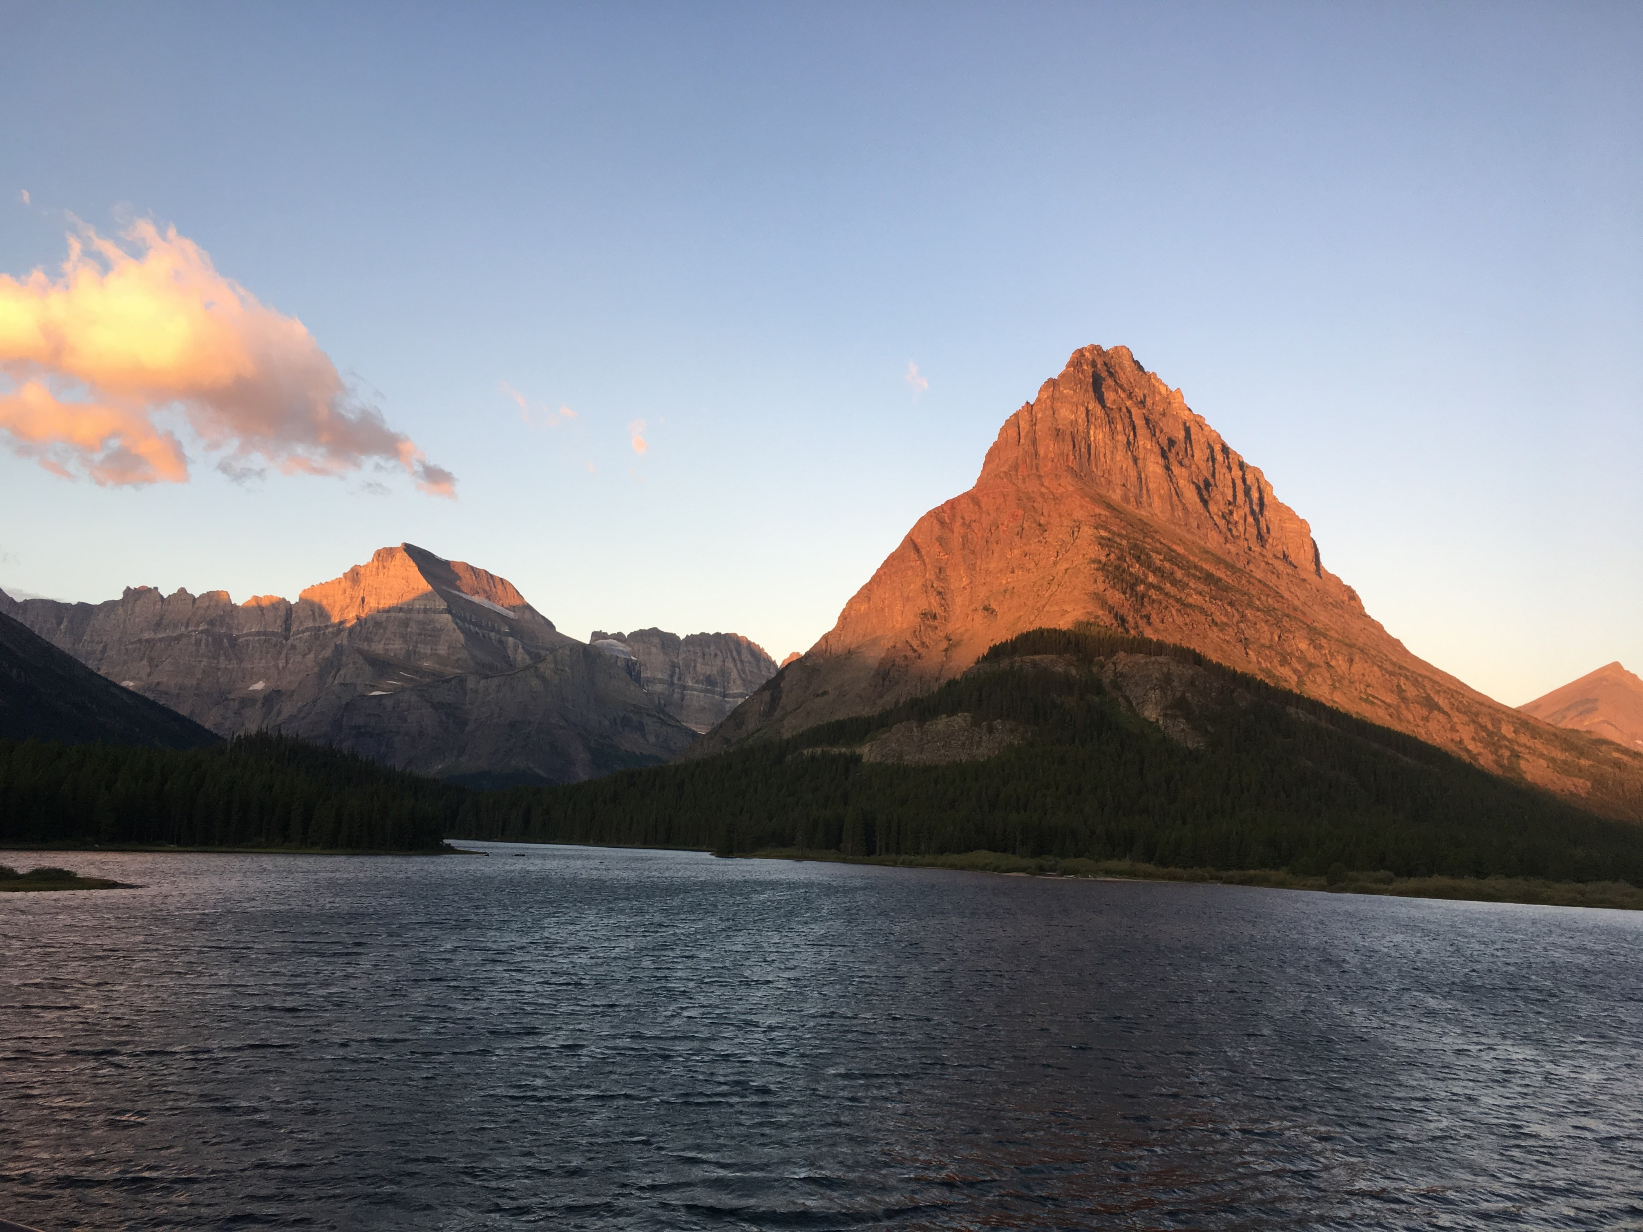
Step 7b: WRAP Alternative Glidepath – Under Design
Glacier National Park

